Slide 1
Market Research
Felix Zhou

Slide 2
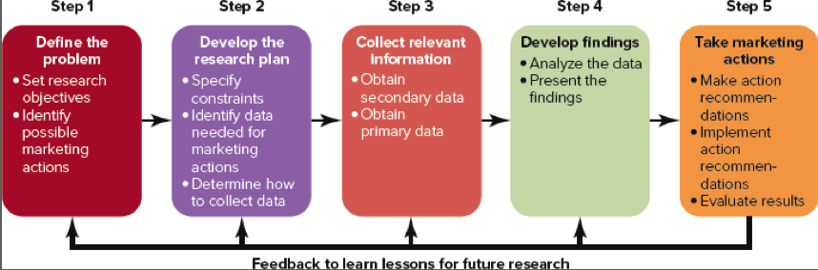
What is Market Research?
Types of Market Research
Interviews
Focus Groups
Product/Service Use Research
Buyer Persona
Pricing Research
Competitive Analysis
Brand-awareness
Campaign Research
Definition:
Market research is the process of gathering information about your target market and customers to verify the success of a new product, iterate on an existing product, or understand brand perception,

Slide 3
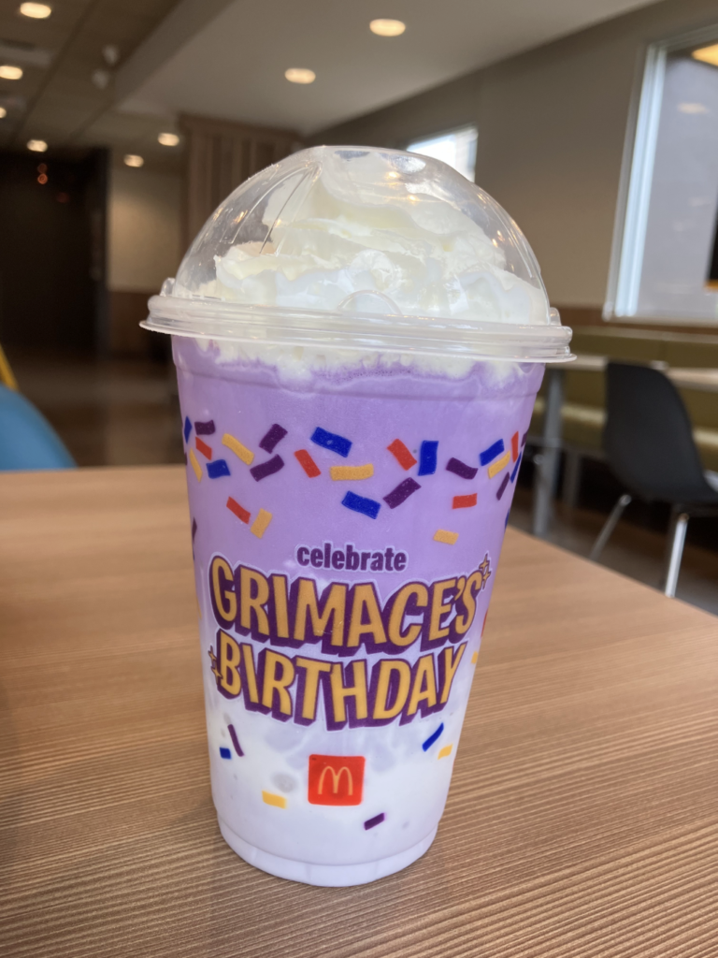
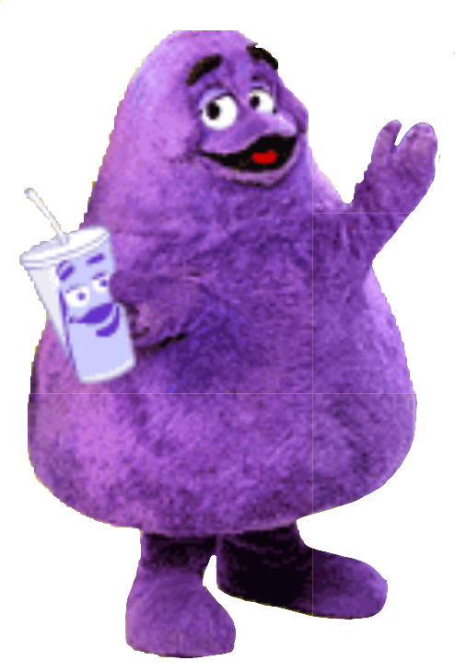

McDonalds and Grimace
With the launch of Burger King’s “Spiderverse” Whopper, containing a vibrant red bun, McDonald’s utilized competitive analysis to wait for the end of BK’s campaign to maximize impressions while the trend is still high.
Using prior data for collaborations with popular artists like Travis Scott and BTS, and limited edition items like the Shamrock shake, McDonald’s decided to combine the two and create a limited edition shake based off a nostalgic character to celebrate his birthday.

Slide 4
Work Cited
Andrew, S. (2023, June 30). How the McDonald’s grimace shake became the stuff of nightmares on TikTok | CNN business. CNN. https://edition.cnn.com/2023/06/28/business/mcdonalds-grimace-shake-tiktok-cec/index.html

